Slide 1

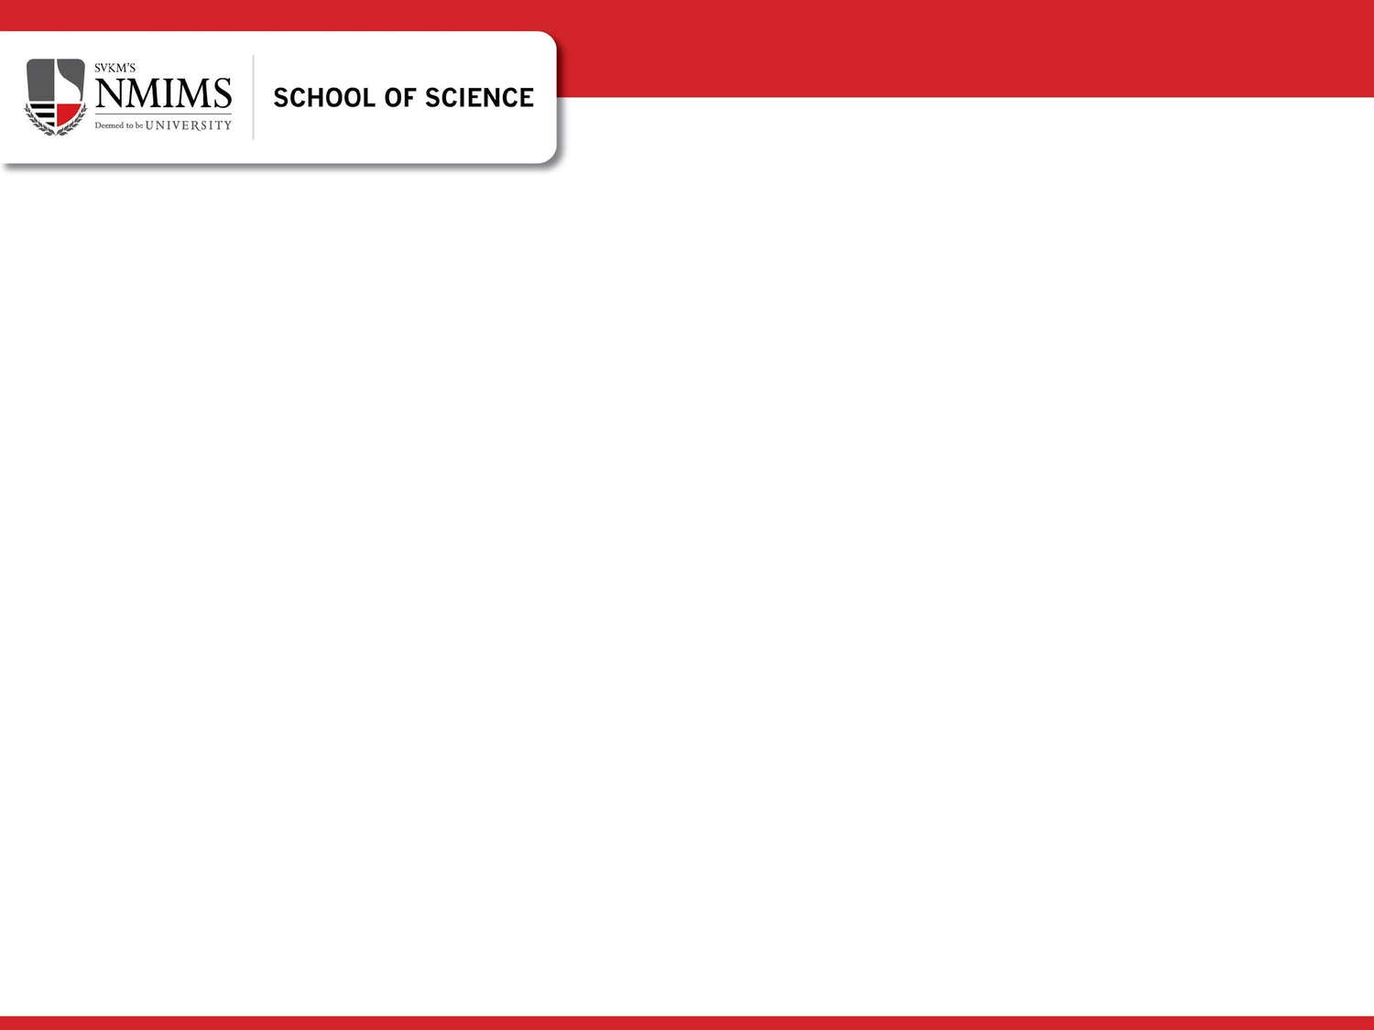
Nilkamal School of Mathematics, Applied Statistics & Analytics
Decoding Discount Preferences in the Apparel Industry
Mentored by : Dr. Rushina Singhi
A001 - Deepasha Kapadia
A007 - Grishma Mehta
A012 - Ishita Pednekar
A051 - Shreeya Thomas
A061 - Abhishek Barve

Slide 2
Nilkamal School of Mathematics, Applied Statistics & Analytics
Nilkamal School of Mathematics, Applied Statistics & Analytics
Table Of Contents
Sr. No. | Title
1 | Introduction
2 | Literature Review
3 | Research Methodologies
4 | Objectives
5 | Data Analysis
6 | Findings and Conclusion
7 | Limitations
8 | Future Scope
9 | References

Slide 3
Nilkamal School of Mathematics, Applied Statistics & Analytics
Nilkamal School of Mathematics, Applied Statistics & Analytics
Introduction
Discounts are no longer just promotions, they're essential tools for customer acquisition and retention in today's competitive retail market (Smith & Johnson, 2020).
Shoppers now face a constant stream of diverse deals, from simple percentage-offs to complex limited time offers with minimum spends (Chen et al., 2021).
However, a universal discount strategy fails because individual psychological traits like impulsiveness and deal proneness cause varied customer responses (Khan & Lee, 2022).
The solution requires moving beyond basic demographics to identify which specific discount attributes (value, expiry, conditions) actually drive purchases for different shoppers (Grant, 2019).
This study addresses that gap by segmenting consumers based on psychology and preferences, creating a framework for data-driven, personalised promotions.

Slide 4
Nilkamal School of Mathematics, Applied Statistics & Analytics
Nilkamal School of Mathematics, Applied Statistics & Analytics
Literature Review
The study combines four established analytical techniques, Conjoint Analysis (CA), Structural Equation Modelling (SEM), K-means Clustering, and Logistic Regression into a single framework to bridge preference measurement and behavioural prediction (Head & Ziolkowski, 2012).
Based on Wang & Wu (2014) and De Bruyn et al. (2008), CA was applied to estimate consumer utilities for key discount attributes (type, expiry, minimum spend, redemption). This step captures how consumers value different offer combinations while minimising survey fatigue.
Grounded in the Theory of Planned Behaviour (TPB), SEM was used to explore how Attitude, Subjective Norms, Perceived Behavioural Control, Intention, and Behaviour influence coupon usage. Similar to Sentosa & Mat (2012), this step explains why consumers act on their preferences rather than just what they prefer.
Using outputs from CA and SEM, K-means clustering was performed to identify distinct consumer segments. This approach overcomes the limitations noted by John et al. (2023) and Vrhovac et al. (2024), who emphasised that demographic or transactional segmentation often fails to capture behavioural diversity.
Following Chakraborty & Cole (1991), Logistic Regression modelled the probability of purchase by integrating conjoint utilities, SEM scores, and cluster identities. This predictive model highlights which psychological and behavioural variables most strongly influence actual coupon redemption.
Unlike prior studies that used these techniques in isolation, this framework connects CA → SEM → Clustering → Logistic Regression, creating a coherent path from consumer preference to purchase prediction. It fulfils the methodological need outlined by Langen & Huber (2023) for integrated, data driven insights that move toward causal understanding in marketing analytics.

Slide 5
Nilkamal School of Mathematics, Applied Statistics & Analytics
Nilkamal School of Mathematics, Applied Statistics & Analytics
Research Methodologies
1. Data Collection
A structured online questionnaire was developed using Google Forms to collect primary data. The survey was designed with seven distinct sections to comprehensively capture respondent profiles, shopping behaviors, and psychological constructs relevant to the study.
2. Instrument Design and Measures
The survey instrument incorporated multi-item scales to measure key psychological constructs, including:
Attitude, Subjective Norms, Perceived Behavioural Control, and Purchase Intention, measured on a 7-point Likert scale (from 1 = Strongly Disagree to 7 = Strongly Agree).
A Conjoint section to analyse consumer preferences for specific discount attributes
This multi-faceted design directly supports the application of advanced analytical techniques, including Structural Equation Modelling (SEM), Cluster Analysis, and Logistic Regression.
3. Sample Characteristics
The final dataset comprised 253 valid responses, providing a robust foundation for statistical analysis.
4. Data Analysis Framework
The data analysis was conducted using Python (with libraries including Pandas, NumPy, Scikit-learn, and StatsModels) and involved a multi-stage process:

Slide 6
Nilkamal School of Mathematics, Applied Statistics & Analytics
Nilkamal School of Mathematics, Applied Statistics & Analytics
Objectives
To develop an integrated analytical framework to understand, segment, and predict consumer responses to discount deals:
Study 1: To identify key discount attributes influencing consumer choice and quantify attribute importance and part-worth utilities.
Study 2: To examine psychological drivers of purchase intention.
Study 3: To segment consumers into homogeneous groups.
Study 4: To predict the likelihood of purchase when consumers receive preferred offers, linking preference and behavioral data.
Study 5: To study application of the Integrated Framework.

Slide 7
Nilkamal School of Mathematics, Applied Statistics & Analytics
Nilkamal School of Mathematics, Applied Statistics & Analytics
Exploratory Data Analysis
Demographic Factor | Key Finding | Interpretation
Online Shopping Frequency | 51.4% shop less than monthly | Infrequent but consistent e-commerce engagement
Average Monthly Online Spending | 51% spend <₹2,000 monthly | Price-conscious consumer segment
Monthly Household Income | 44.7% above ₹1,00,000 | Strong purchasing capacity among respondents
Loyalty Program Usage | 56.9% use loyalty programs | Customer openness to incentive-driven engagement
Discount Preference | 65.6% neutral to discount type | Limited sensitivity to personalized vs. general discounts
Table 1

Slide 8
Nilkamal School of Mathematics, Applied Statistics & Analytics
Nilkamal School of Mathematics, Applied Statistics & Analytics
Study 1 : To identify key discount attributes influencing consumer choice

Slide 9
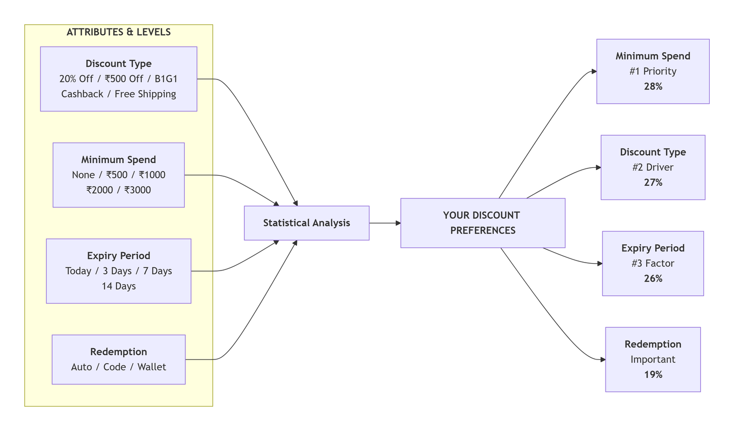
Nilkamal School of Mathematics, Applied Statistics & Analytics
Nilkamal School of Mathematics, Applied Statistics & Analytics
Conjoint Analysis is used in this study to measure consumer preferences for different discount coupon attributes. It helps identify which specific features i.e. discount type, minimum spend, expiry period, and redemption method, are most valued by clothing shoppers and have the greatest impact on their purchase decisions
Fig1

Slide 10
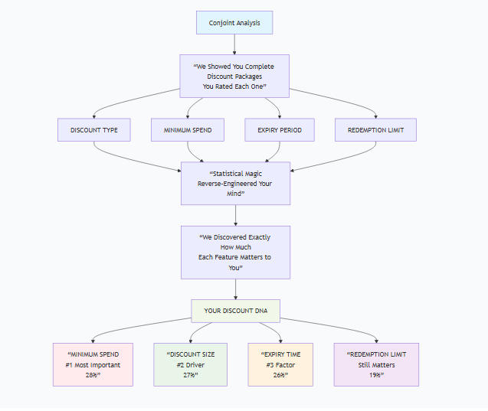
Nilkamal School of Mathematics, Applied Statistics & Analytics
Nilkamal School of Mathematics, Applied Statistics & Analytics
Minimum Spend (28 %) is the most influential factor, showing consumers prefer coupons that require lower spending thresholds for redemption the most.
Discount Type (27 %) and Expiry (26.0%) are almost equally important, indicating that both-the format of the discount (e.g., flat, % off) and the coupon’s validity period significantly shape consumer preference.
Redemption Limit (19 %) has the least influence but still matters, overly restrictive limits can reduce appeal, while flexible use enhances perceived value.
Fig 2

Slide 11
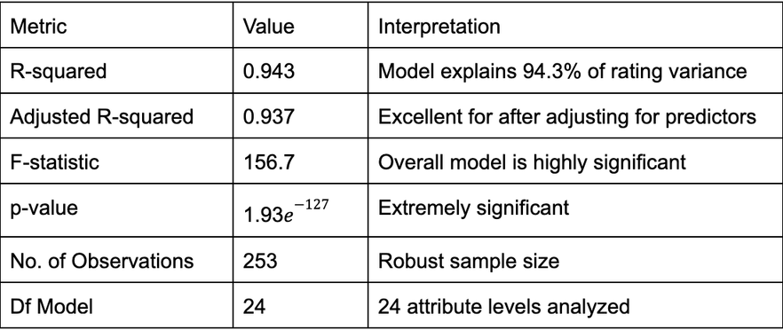
Nilkamal School of Mathematics, Applied Statistics & Analytics
Nilkamal School of Mathematics, Applied Statistics & Analytics
Interpretation
OLS Regression Results Summary
Table 2
All coefficients are statistically significant (p < 0.05)
Strong evidence that every attribute level influences preferences
No redundant features in the model
High predictive power for consumer choices

Slide 12
Nilkamal School of Mathematics, Applied Statistics & Analytics
Nilkamal School of Mathematics, Applied Statistics & Analytics
Part-Worth Utilities
Most Valued Features:
Rs. 200 Cashback Discount (Utility: 1.71)
Rs. 1500 Minimum spend (Utility: 1.51)
5-Days Expiry (Utility: 1.35)
Wallet Credit Redemption (Utility: 1.11)
Least Valued Features:
7-Day Expiry (Utility: 0.17)
Rs. 2000 Minimum Spend (Utility: 0.26)
Automatic at Checkout Redemption (Utility: 0.23)

Slide 13
Nilkamal School of Mathematics, Applied Statistics & Analytics
Nilkamal School of Mathematics, Applied Statistics & Analytics
Study 2 : To examine psychological drivers of purchase intention

Slide 14

Nilkamal School of Mathematics, Applied Statistics & Analytics
Nilkamal School of Mathematics, Applied Statistics & Analytics
I often make purchases spontaneously without much planning.
Discounts and coupons often tempt me to buy things I hadn’t planned to.
I regret impulsive purchases after using a discount.
If I don’t use a discount before it expires, I feel like I missed a great deal.
Limited-time coupons push me to purchase faster.
I often compare my discounts with friends/family to ensure I’m not missing out.
I carefully evaluate discounts to see if they truly give me value.
I prefer coupons that give guaranteed savings over uncertain rewards.
A higher discount percentage always feels more attractive to me.
I trust that companies give genuine discounts and not inflated prices.
I feel secure using online coupons from reputed brands.
I prefer discounts that are simple and transparent.
Using discounts/coupons when I shop is a good idea.
Getting a discount makes the shopping experience more enjoyable.
Using discounts is beneficial for my finances.
Using discounts is a smart way to shop.
Using discounts/coupons is usually a hassle.
People who are important to me think I should use discounts/coupons.
My friends/family often encourage me to use discounts.
Most people in my social circle use coupons for shopping.
I feel social pressure to take advantage of discount offers.
I find it easy to locate and use valid discounts/coupons.
I know how to apply coupons/promotions while shopping online or in-store.
Using discounts requires little effort for me.
(reverse) Problems like expired codes or complicated checkout prevent me from using discounts.
I intend to use discounts/coupons the next time I shop.
I plan to search for discount codes before making purchases.
I will try to use available discount offers in the coming month.
In the past month, how often did you use a discount or coupon when making purchases? (Never / 1–2 times / 3–5 times / 6–10 times / 11+ times) (ordinal)
Approximately what proportion of your purchases last month used some discount? (0–25% / 26–50% / 51–75% / 76–100%) (ordinal)

Slide 15

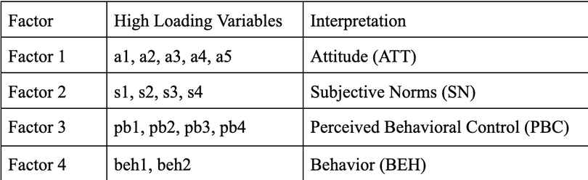
Nilkamal School of Mathematics, Applied Statistics & Analytics
Nilkamal School of Mathematics, Applied Statistics & Analytics
EXPLORATORY FACTOR ANALYSIS
Bartlett’s Test (p = 0.001) confirmed that the correlation matrix was suitable for factor analysis, while the Kaiser-Meyer-Olkin (KMO) measure of 0.903 indicated excellent sampling adequacy.
The analysis extracted five significant latent factors i.e. Attitude (ATT), Subjective Norms (SN), Perceived Behavioural Control (PBC), Behavioural Intention (INT), and Actual Behaviour (BEH).
Table 3

Slide 16
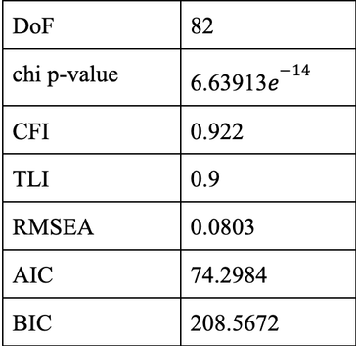
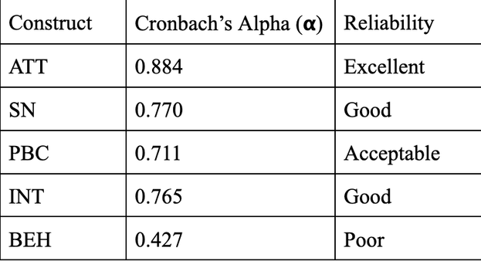
Nilkamal School of Mathematics, Applied Statistics & Analytics
Nilkamal School of Mathematics, Applied Statistics & Analytics
CONFIRMATORY FACTOR ANALYSIS
The objective was to validate the factor structure and assess the model’s fit.
Measurement model
ATT =~ a1 + a2 + a3 + a4
SN =~ sn1 + sn2 + sn3
PBC =~ pb1 + pb2 + pb3
INT =~ bint1 + bint2 + bint3
BEH =~ beh1 + beh2
Structural model
INT ~ ATT + SN + PBC
BEH ~ INT + PBC
Table 4
Table 5

Slide 17
Nilkamal School of Mathematics, Applied Statistics & Analytics
Nilkamal School of Mathematics, Applied Statistics & Analytics
Theory of Planned Behavior
The CFA-validated constructs, Attitude (ATT), Subjective Norm (SN), Perceived Behavioural Control (PBC), Intention (INT), and Behaviour (BEH) align perfectly with the TPB framework.
Attitude, SN, and PBC → influence → Behavioral Intention (INT)
Behavioral Intention (INT) → drives → Actual Behavior (BEH)
The CFA model statistically validates these theoretical relationships, providing empirical support for TPB in the context of consumer purchase behaviour.

Slide 18
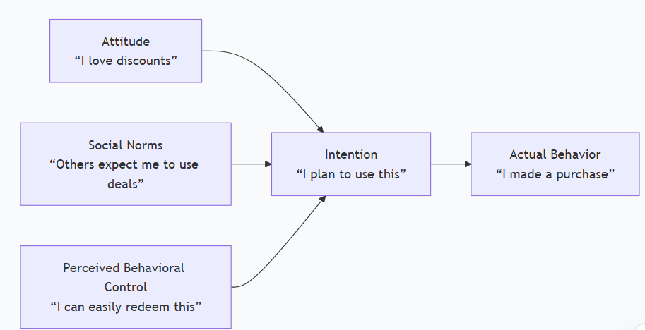
Nilkamal School of Mathematics, Applied Statistics & Analytics
Nilkamal School of Mathematics, Applied Statistics & Analytics
Theory of Planned Behavior: Our Psychological Framework
Fig 3

Slide 19
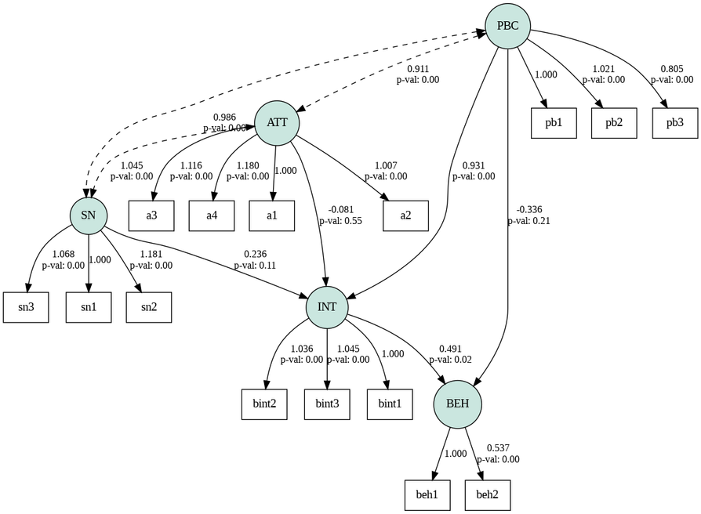
Nilkamal School of Mathematics, Applied Statistics & Analytics
Nilkamal School of Mathematics, Applied Statistics & Analytics
SEM PLOT
Fig 4

Slide 20
Nilkamal School of Mathematics, Applied Statistics & Analytics
Nilkamal School of Mathematics, Applied Statistics & Analytics
Study 3 : To segment consumers into homogeneous groups

Slide 21
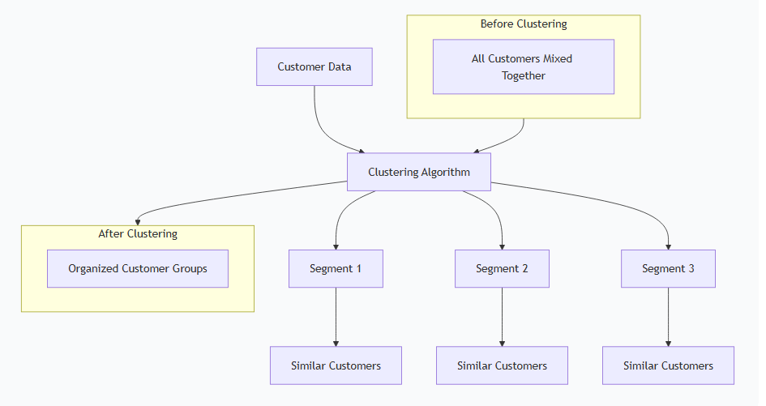
Nilkamal School of Mathematics, Applied Statistics & Analytics
Nilkamal School of Mathematics, Applied Statistics & Analytics
Clustering is used in this study to segment customers into distinct groups based on their psychological traits, shopping behaviors, and responses to discount coupons. This helps identify different customer types in the clothing market for targeted marketing strategies.
Fig 5

Slide 22
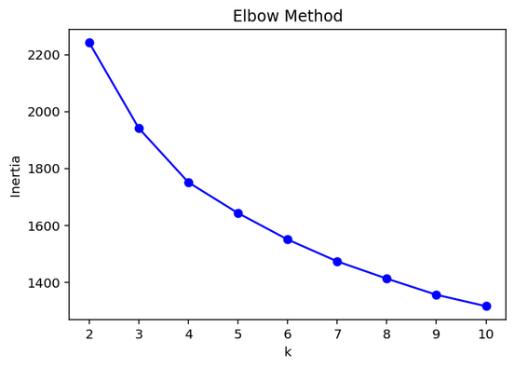
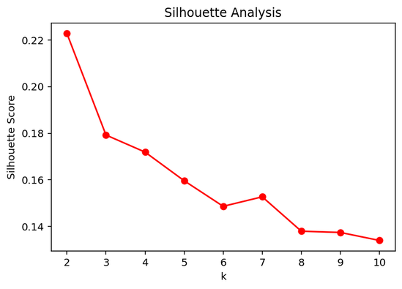
Nilkamal School of Mathematics, Applied Statistics & Analytics
Nilkamal School of Mathematics, Applied Statistics & Analytics
Elbow Method
Silhouette score
Fig 6
Fig 7

Slide 23
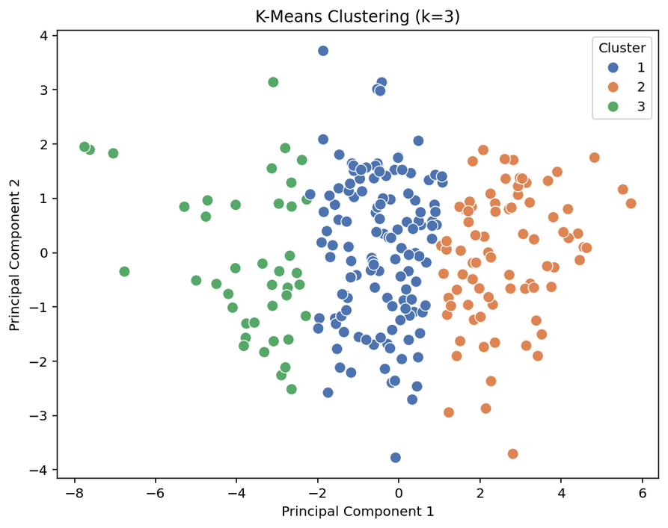
Nilkamal School of Mathematics, Applied Statistics & Analytics
Nilkamal School of Mathematics, Applied Statistics & Analytics
Cluster Visualisation
Fig 8

Slide 24
Nilkamal School of Mathematics, Applied Statistics & Analytics
Nilkamal School of Mathematics, Applied Statistics & Analytics
Characteristics of Clusters
Balanced across all decision factor.
Practical approach to deal evaluation.
Values good offers with reasonable conditions.
Targeting: Standard promotions, bundle deals, seasonal offers.
Cluster 1 :
The Balanced Pragmatists
(132)
Extremely high deal responsiveness.
Will actively seek and pursue best offers.
Values premium discounts and exclusive access.
Targeting: VIP early access, tiered discounts, loyalty programs.
Cluster 2:
The Deal-Hunters
(80)
Cluster 3 :
The Hard-to-Please Skeptics
(41)
Extremely low responsiveness to standard offers.
Requires exceptional value with zero risk.
Needs strong trust signals and guarantees.
Targeting: Cashback guarantees, free trials, social proof.

Slide 25
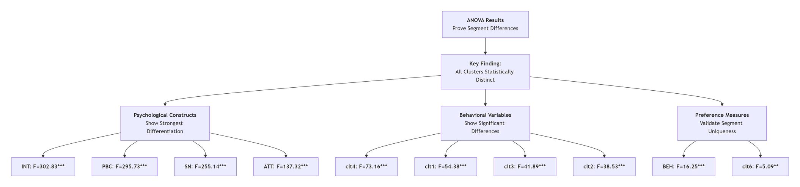
Nilkamal School of Mathematics, Applied Statistics & Analytics
Nilkamal School of Mathematics, Applied Statistics & Analytics
Heterogeneity Among Clusters
We validated our identified customer clusters using One-Way ANOVA to examine whether differences among segments were statistically significant.
The results confirm that all clusters differ significantly (p < 0.001) across psychological, behavioural, and preference based measures, indicating strong heterogeneity within our sample.
Fig 9

Slide 26
Nilkamal School of Mathematics, Applied Statistics & Analytics
Nilkamal School of Mathematics, Applied Statistics & Analytics
Study 4 : To predict the likelihood of purchase when consumers receive preferred offers

Slide 27
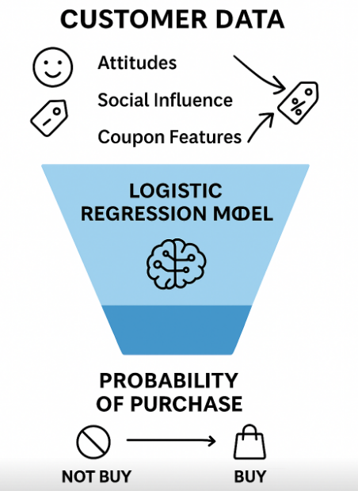
Nilkamal School of Mathematics, Applied Statistics & Analytics
Nilkamal School of Mathematics, Applied Statistics & Analytics
Logistic Regression is used in this study to predict the probability of purchase when customers receive their preferred discount coupons.
Key Output: A probability score instead of a simple yes/no, enabling targeted marketing.
The Influencing Factors:
Customer Psychology: Attitude, social influence, and purchase intention.
Coupon Attributes: Discount value, expiry time, and minimum spend rules.
Personal Preferences: The individual importance a customer places on different coupon features.
Identify which factors most strongly drive a purchase decision, allowing brands to optimize offers for maximum conversion.
Fig 10

Slide 28
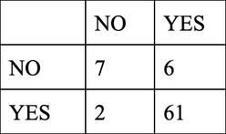
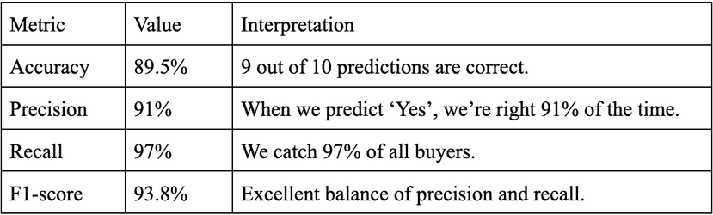
Nilkamal School of Mathematics, Applied Statistics & Analytics
Nilkamal School of Mathematics, Applied Statistics & Analytics
Model Performance
Confusion Matrix Results:
Predicted
Actual
Table 6
Performance Metrics:
Table 7

Slide 29
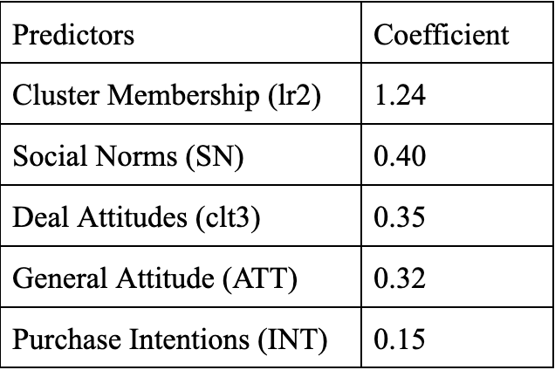
Nilkamal School of Mathematics, Applied Statistics & Analytics
Nilkamal School of Mathematics, Applied Statistics & Analytics
Top Influential Predictors
Ranked by Impact:
Table 8

Slide 30
Nilkamal School of Mathematics, Applied Statistics & Analytics
Nilkamal School of Mathematics, Applied Statistics & Analytics
Study 5 : Application of the Integrated Framework

Slide 31
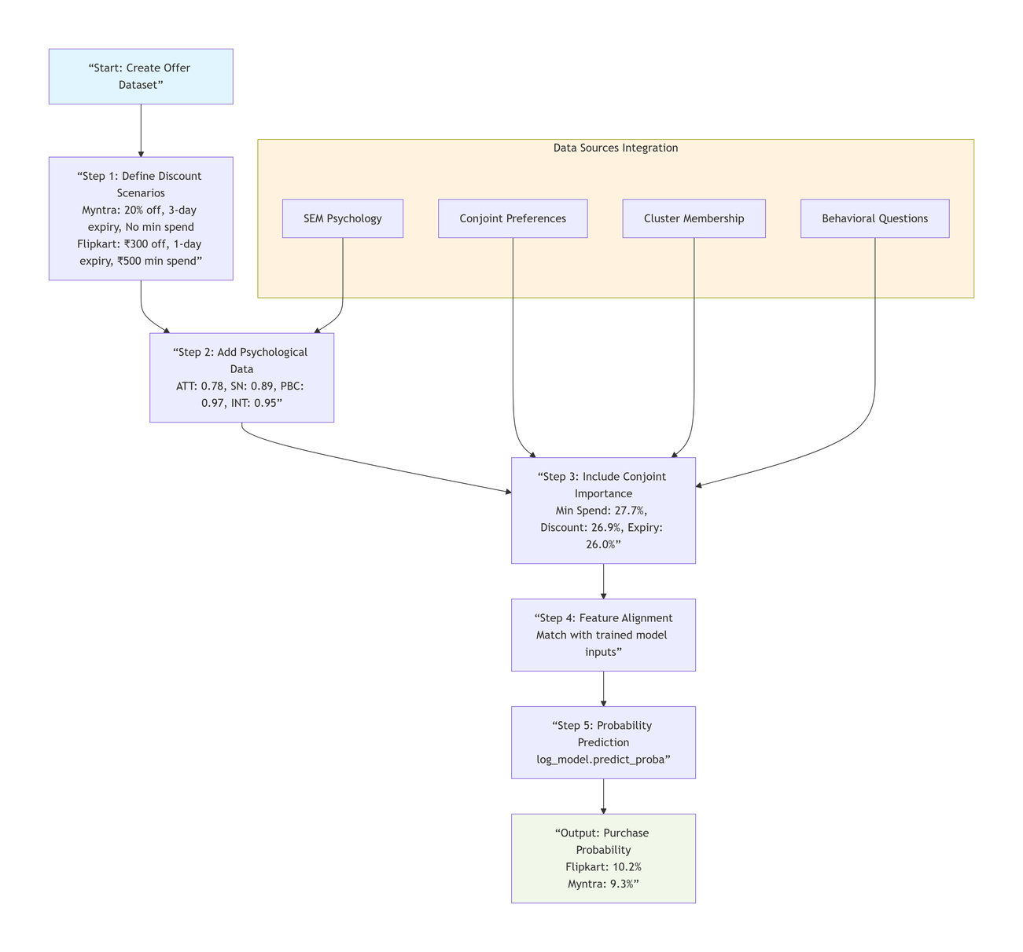
Nilkamal School of Mathematics, Applied Statistics & Analytics
Nilkamal School of Mathematics, Applied Statistics & Analytics
Implementation – Predicting Purchase Probability
Predict which discount offer a customer will use.
The Process:
1. Create Offers:
Myntra: 20% off, 3-day expiry, no minimum spend
Flipkart: ₹300 off, 1-day expiry, ₹500 minimum spend
2. Add Customer Psychology:
scores: ATT: 0.78, SM: 0.89, PBC: 0.97, INT: 0.95
3.Add Preference Weights:
What matters most to this customer:
Minimum Spend (27.7%)
Discount Type (26.9%)
Expiry Time (26.0%)
4. Run Prediction:
Feed all this data into a trained model
Model calculates purchase probability for each offer
The Result:
Flipkart offer: 10.2% chance of purchase
Myntra offer: 9.3% chance of purchase
Fig 11

Slide 32
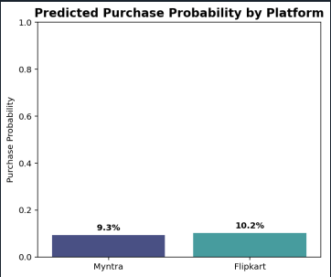
Nilkamal School of Mathematics, Applied Statistics & Analytics
Nilkamal School of Mathematics, Applied Statistics & Analytics
Output: Predicted Conversion Probabilities
Fig 12

Slide 33
Nilkamal School of Mathematics, Applied Statistics & Analytics
Nilkamal School of Mathematics, Applied Statistics & Analytics
Interpretation and Conclusions
1. Defining the Optimal Discount Product
Marketers can use the Conjoint Analysis (CA) results to design the base parameters of the offer, ensuring it captures maximum initial customer preference.
2. Utilising Psychological Triggers
The Structural Equation Modelling (SEM) results explain why consumers convert their preference into action. Marketers must target these psychological levers to push customers from initial interest (Conjoint Analysis) to purchase commitment (Logistic Regression).
3. Personalising Actionable Segments
The clustering stage moves the marketer beyond aggregate data analysis by creating three statistically distinct and meaningful consumer segments based on unique psychological profiles and preference priorities.

Slide 34
Nilkamal School of Mathematics, Applied Statistics & Analytics
Nilkamal School of Mathematics, Applied Statistics & Analytics
Limitations
The study identified that the construct measuring Actual Behaviour (BEH) had low reliability (α = 0.427). This low reliability is noted as a common challenge when measuring self reported behaviour with limited items
The three consumer tribes were identified from a specific, geographically and demographically bounded sample (predominantly 18 to 24 year olds, highly educated). Their stability over time and generalisability to other markets (e.g., different age groups or cultures) is not yet proven.
The results showed a crucial distinction between preference and action: Conjoint importance scores for attributes like "Minimum Spend" and "Expiry" determined initial preference, but had coefficients effectively equal to zero in predicting final purchase behavior
The Logistic Regression model achieved high accuracy (89.5%), but this performance may be slightly inflated due to smaller sample size (253 responses)

Slide 35
Nilkamal School of Mathematics, Applied Statistics & Analytics
Nilkamal School of Mathematics, Applied Statistics & Analytics
Future Scope
Integrate the model with live e-commerce platforms. Use the clustering and logistic regression model to segment users in real-time based on their browsing behavior and past purchases, moving beyond survey-based ‘BEH’ to actual clickstream and conversion data.
Develop a system that uses the cluster assignment and conjoint utilities of a logged-in user to dynamically generate and display their "perfect" discount deal in real-time.
Conduct a follow-up study incorporating the most influential attributes from this research (e.g., Minimum Spend) with new ones, such as "Product Category" or "Payment Method Discounts," to build a more comprehensive preference model.
Track the same cohort of respondents over time to see if their cluster membership changes based on life events, economic shifts, or marketing exposure. This tests the stability of the segments.

Slide 36
Nilkamal School of Mathematics, Applied Statistics & Analytics
Nilkamal School of Mathematics, Applied Statistics & Analytics
References
Wang, C. H., &amp; Wu, C. W. (2014). Combining conjoint analysis with Kano model to optimize product varieties of smart phones: A VIKOR perspective. Journal of Industrial and Production Engineering, 31(4), 177-186.
Head, M., &amp; Ziolkowski, N. (2012). Understanding student attitudes of mobile phone features: Rethinking adoption through conjoint, cluster and SEM analyses. Computers in Human Behaviour, 28(6), 2331-2339.
Vrhovac, V., Orošnjak, M., Ristić, K., Sremčev, N., Jocanović, M., Spajić, J., &amp;Brkljač, N. (2024). Unsupervised Modelling of E-Customers’ Profiles: Multiple Correspondence Analysis with Hierarchical Clustering of Principal Components and Machine Learning Classifiers. Mathematics, 12(23), 3794.
Ufeli, C. P., Sattar, M. U., Hasan, R., &amp; Mahmood, S. (2025). Enhancing Customer Segmentation Through Factor Analysis of Mixed Data (FAMD)-Based Approach Using K-Means and Hierarchical Clustering Algorithms. Information, 16(6), 441.
Paetz, F., Hein, M., Kurz, P., &amp; Steiner, W. J. (2019). Latent class conjoint choice models: A guide for model selection, estimation, validation, and interpretation of results. Marketing ZFP 41: 3–20.
De Bruyn, A., Liechty, J. C., Huizingh, E. K., &amp; Lilien, G. L. (2008). Offering online recommendations with minimum customer input through conjoint-based decision aids. Marketing Science, 27(3), 443-460.
John, J. M., Shobayo, O., &amp; Ogunleye, B. (2023). An exploration of clustering algorithms for customer segmentation in the UK retail market. Analytics, 2(4), 809-823.
Sentosa, I., &amp; Mat, N. K. N. (2012). Examining a theory of planned behaviour (TPB) and technology acceptance model (TAM) in internet purchasing using structural equation modelling. Researchers World, 3(2 Part 2), 62.
Zumstein, D., &amp; Kotowski, W. (2020, April). Success factors of e-commerce-drivers of the conversion rate and basket value. In 18th International Conference e-Society 2020 (pp. 43-50).
Chakraborty, G., &amp; Cole, C. (1991). Coupon characteristics and brand choice. Psychology &amp; Marketing, 8(3), 145-159.
Langen, H., &amp; Huber, M. (2023). How causal machine learning can leverage marketing strategies: Assessing and improving the performance of a coupon campaign. Plos one, 18(1), e0278937.

Slide 37
Nilkamal School of Mathematics, Applied Statistics & Analytics
Nilkamal School of Mathematics, Applied Statistics & Analytics
Thank You

